Slide 1



A Contractors Guide to Installation Access
36th Security Forces Squadron/S5B

Slide 2
Overview
Hours of Operation
How to Sponsor
Approved IDs
Use of Contracts
Base Access Request (BAR)
Base Access List (BAL)
Foreign Visitor Request (FVR)

Slide 3
Hours of Operation
The Visitor Control Center (Bldg. 14615) is located adjacent to the North Gate.
The Pass and ID Office (Bldg. 2403) is located adjacent to the Main Gate.
Pass and ID (366-5650) is where all contracts and requests will be dropped off and processed, as well as where tracking numbers are first given.
VCC (366-5477) is where passes will be picked up after contracts or request have been fully processed
Monday | Tuesday | Wednesday | Thursday | Friday | Saturday | Sunday
0600-1400 | 0600-1400 | 0600-1400 | 0600-1400 | 0600-1400 | 0800-1100, 1100-1200 (lunch) 1200-1600 | Closed
Monday | Tuesday | Wednesday | Thursday | Friday | Saturday | Sunday
0800-1600 | 0800-1600 | 0800-1600 | 0800-1600 | 0800-1600 | Closed | Closed

Slide 4

How to Sponsor Guests On Base
Procced to the VCC (North gate) with sponsor and all visiting guest
Ensure sponsor is present with their CAC card
Guest will have Real ID and SSN ready to go
NOTE: We recommend sponsor’s use the provided QR Code to get a head start for their visitors. Also, all forms can be found on the QR Code’s site.

Slide 5
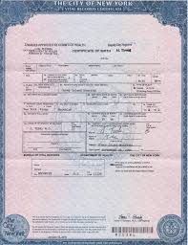
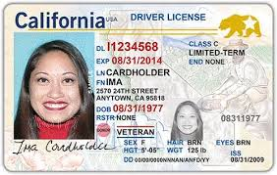
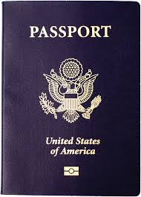
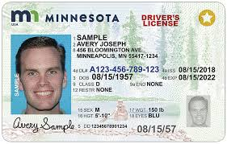
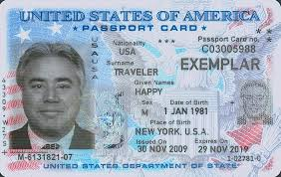
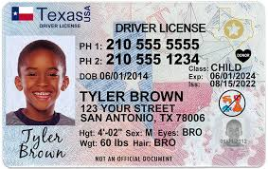
Approved IDs
Drivers Licenses with a Birth Certificate
U.S., FSM, Marshal Islands, and Palau Passports
Real IDs

Slide 6
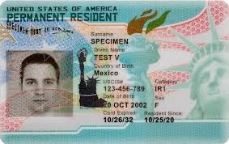
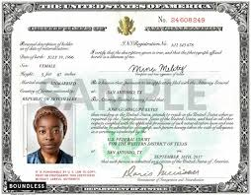
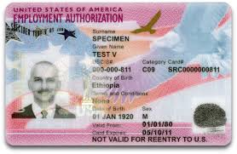
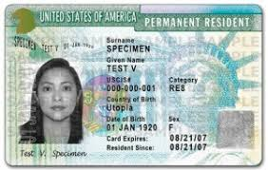
Approved IDs Continued
Employment Authorization Card
Naturalization Certificate
Green Card

Slide 7
Use of Contracts
Contracts are used by companies or squadrons to gain access to AAFB for work related reasons.
Paperwork will be completed by company or squadron and hand delivered to the Pass and ID Office (Bldg. 2403)
Tracking numbers will be provided once paperwork is accepted.
Contracts cannot exceed 1 year.
Any approving official signing off on any contract MUST be on an Authorized Signature List. (If wet signed, must have DoD ID#)
Allow 5-7 business days for contract processing. Contact Pass and ID office WITH tracking number to see if passes are processed and ready for pick up.

Slide 8
Base Access Request (BAR)
Base Access Request (BAR) will be the main way companies can get employees onto base.
It includes a Coversheet, Interstate Identification Index (Triple III) Log , and a Base Access Affidavit.
After all paperwork is completed, each Base Access Affidavit will be followed by photocopies of valid and accepted IDs.

Slide 9
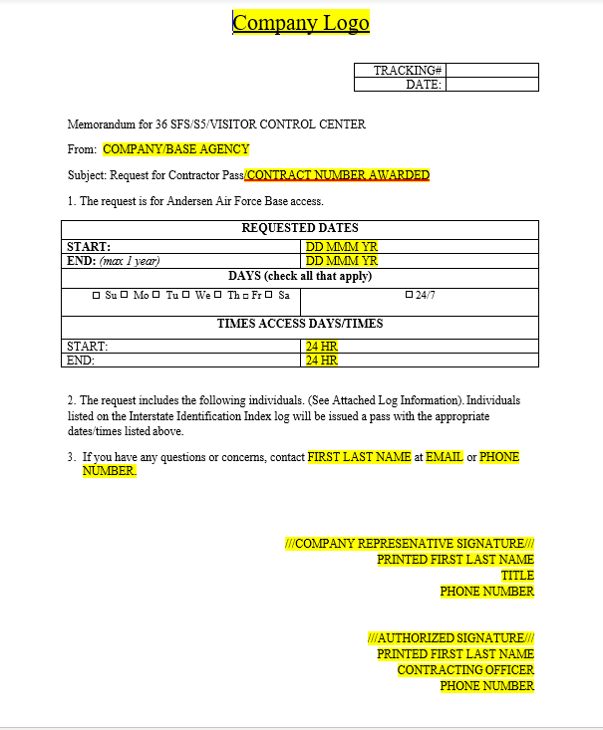
Base Access Request (BAR) Cont.
Coversheet will be the first page of any BAR.
This will include all important information including dates, times, contact information, and verified signatures.
An important thing to note is that times cannot conflict with each other.

Slide 10
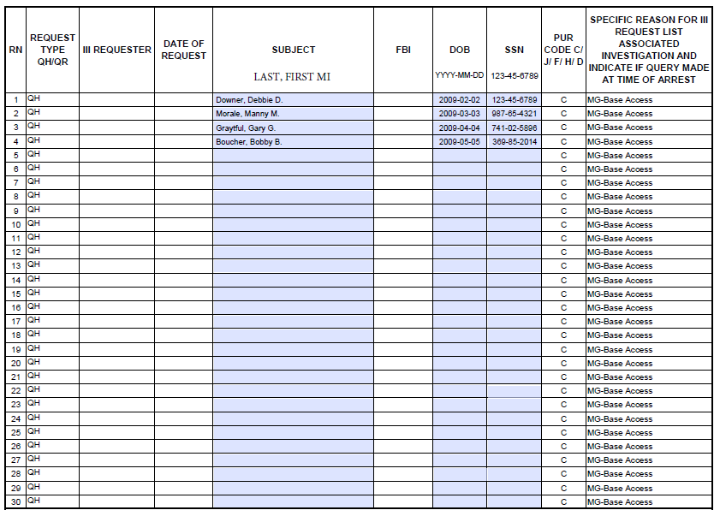
Base Access Request (BAR) Cont.
Interstate Identification Index (Triple III) Log
Information must be typed in
Step 1. Fill out visitor information
Step 2. Add date of birth in the YYYY-MM-DD format
Step 3. Add SSN in the XXX-XX-XXXX format
1
2
3

Slide 11
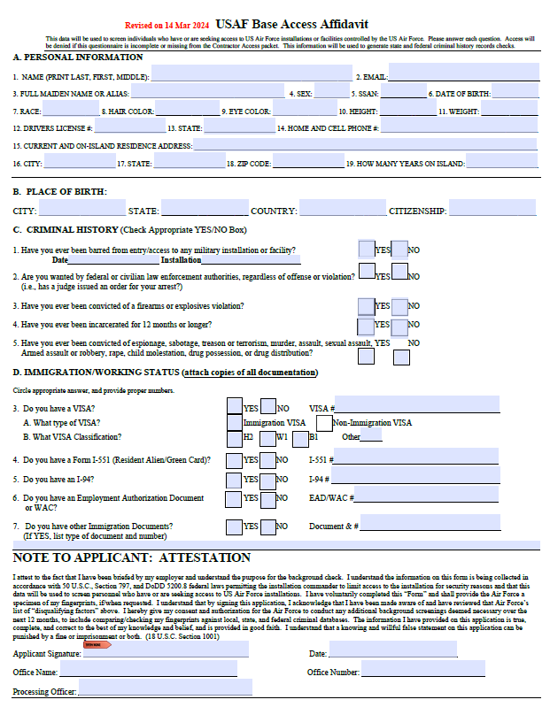
Base Access Request (BAR) Cont.
Base Access Affidavit will be after Triple I (III) Log.
All areas in blue will be filled and completed.
EACH employee that is listed on Triple III Log will need a filled out and completed Base Access Affidavit.
Photocopies of real and valid IDs will be followed by each affidavit.

Slide 12
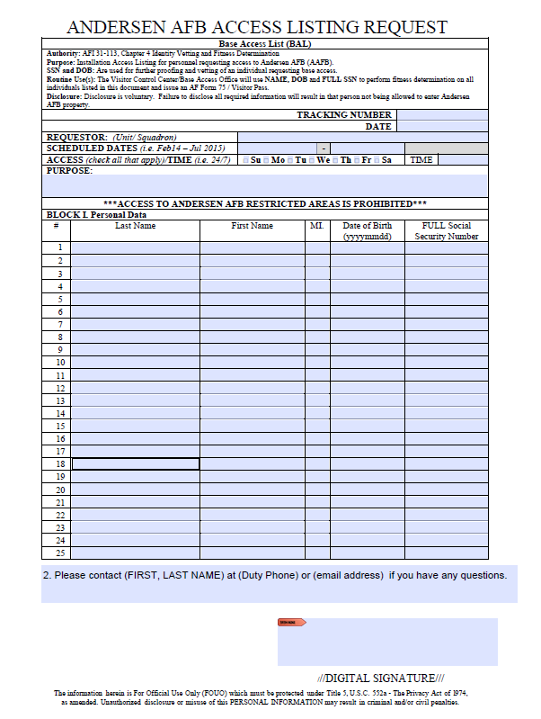
Base Access List (BAL)
Base Access List (BAL) is used for short-term contracts that specific squadrons need.
BALs do NOT need Coversheets or Triple I (III) Logs as all needed information will be listed on front of BAL as seen here.
Base Access Affidavit will still follow as well as photocopies of real and valid IDs.

Slide 13
Foreign Visitor Request (FVR)
Foreign Visitor Request (FVR) are specifically for Foreigners who do not have any U.S. IDs
Company will fill out FVR for the employees.

Slide 14
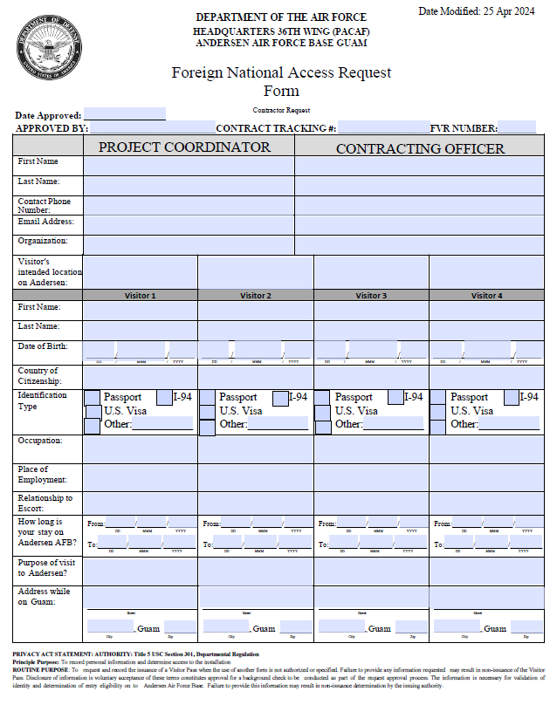
Foreign Visitor Request (FVR) Cont.
Step 1: Project Coordinator and Contracting Officer will fill in their own information as listed
Step 2: Each visitor’s information will be placed in required areas.
If multiple visitors are foreigners, fill each slot till the fourth visitor BEFORE starting a new FVR sheet.
Ensure it’s in alphabetical order. MUST be typed, NOT handwritten.
Proper photocopies must be included such as , Passports, Visas, Labor IDs (H2), 797-A, and updated I-94.
1
2

Slide 15
Questions?
For assistance during duty hours, call us at 366-5650 (Pass and ID) or 366-5477 (Visitor Control Center). For concerns after hours, please call 362-4638.

