Slide 1



An Airman’s Guide to Installation Access
36th Security Forces Squadron/S5B

Slide 2
Overview
Hours of Operation
Sponsoring of Guest
Approved IDs
Forms For You
Special Events Pass (SPE)
Special Purpose Pass (SPP)
AF Form 75, Visitors Pass

Slide 3
Hours of Operation
The Visitor Control Center (Bldg. 14615) is located adjacent to North Gate.
The Pass and ID Office (Bldg. 2403) is located adjacent to the Main Gate.
If you are seeking base access after hours, please head to the nearest operational gate. 36 Security Forces Squadron personnel have been trained to issue out temporary passes via AF Form 75 (see slide 11)
Monday | Tuesday | Wednesday | Thursday | Friday | Saturday | Sunday
0600-1400 | 0600-1400 | 0600-1400 | 0600-1400 | 0600-1400 | 0800-1100, 1100-1200 (lunch) 1200-1600 | Closed
Monday | Tuesday | Wednesday | Thursday | Friday | Saturday | Sunday
0800-1600 | 0800-1600 | 0800-1600 | 0800-1600 | 0800-1600 | Closed | Closed

Slide 4

How to Sponsor Guests On Base
Procced to the VCC (North gate) with sponsor and all visiting guest
Ensure sponsor is present with their CAC card
Guest will have Real ID and SSN ready to go
NOTE: We recommend sponsor’s use the provided QR Code to get a head start for their visitors. Also, all forms can be found on the QR Code’s site.

Slide 5
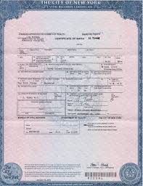
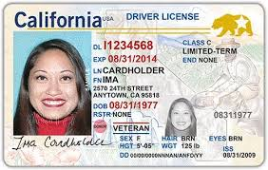
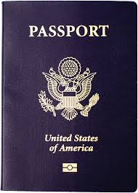
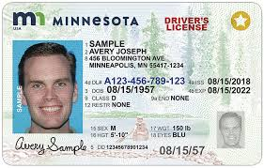
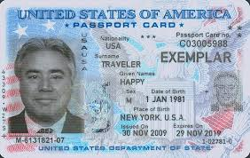
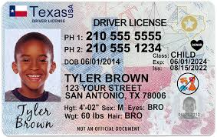
Approved IDs
Drivers Licenses with a Birth Certificate
U.S., FSM, Marshal Islands, and Palau Passports
Real IDs

Slide 6
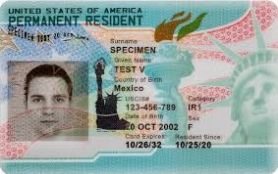
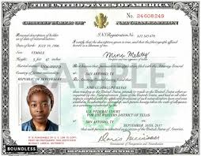
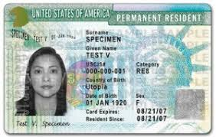
Approved IDs Continued
Green Card
Naturalization Certificate

Slide 7
Forms For You
Special Purpose Pass (SPP)
Only used for visiting family members from off-island
It is recommended that you start this process TWO WEEKS prior
Special Events Pass (SPE)
Used for special events that occur on the installation that has a large amounts of guest (ex: kids birthday party)
It is recommended that you start this process TWO WEEKS prior
AF Fm 75, Visitors Pass
Used for visitors accessing during work or after hours
If your visitor is a foreigner, a Foreign Visitor Request (FVR) must be accomplished. This is done at Pass and ID (main gate)

Slide 8
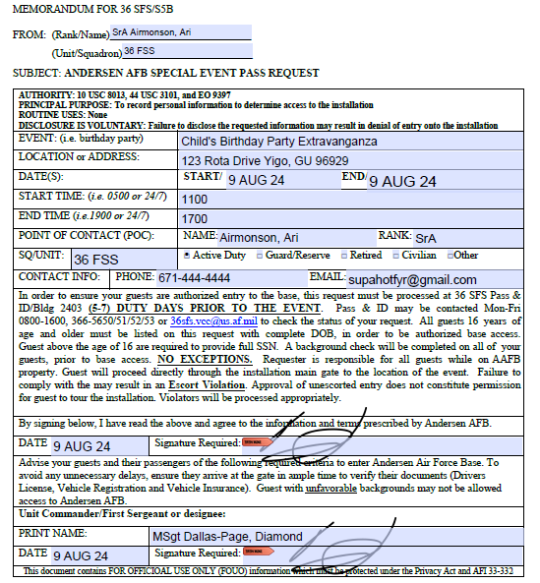
Special Event Pass (SPE)
Step 1. Type or write your rank, name, unit, and squadron information
Step 2. Enter details about the event (location/address, dates/times, and POC information)
Step 3. Sign and obtain Commander/Shirts signature
1
2
3

Slide 9
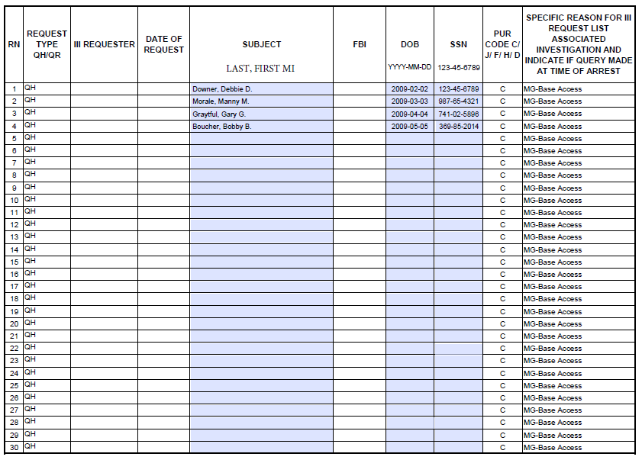
Special Event Pass (SPE) Continued
Information must be typed in
Step 1. Fill out visitor information
Step 2. Add date of birth in the YYYY-MM-DD format
Step 3. Add SSN in the XXX-XX-XXXX format
1
2
3

Slide 10
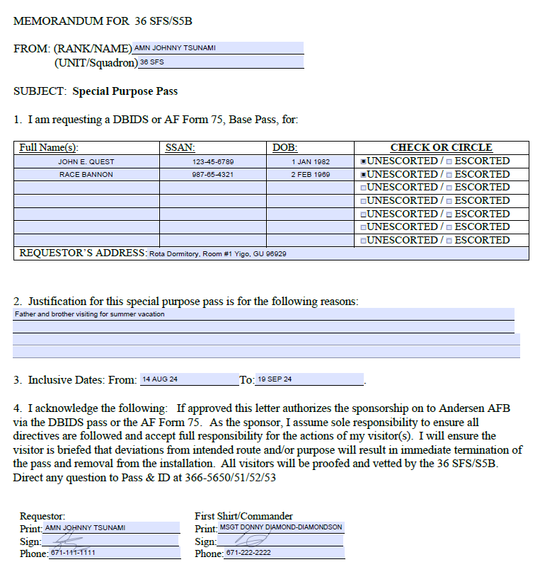
Special Purpose Pass (SPP)
Step 1: Type or write your Rank, Name, Unit, and Squadron information
Step 2: Add guest information on block 1 and choose entry type. NOTE: SSNs and DOBs are needed
Step 3: Provide justification for pass
Step 4: Fill in date information
Step 5: Sign and obtain Commander/Shirts signature
1
2
3
4
5

Slide 11
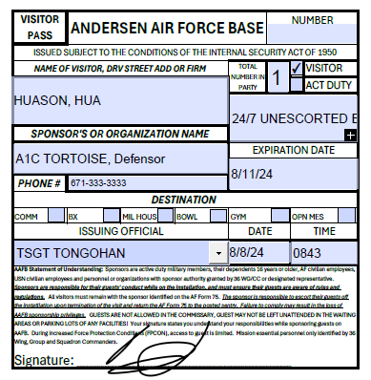
AF Form 75, Visitor Pass
Provided after SPP has been accomplished, when VCC is open, OR during after hours at the gate
If you are sponsoring a foreign visitors, a Foreign Visitor Request (FVR) must be accomplished prior to entry or when using after hours services
FVRs are available online or on-site at Pass and ID (Bldg. 2403)
Step 1. Once issued, have your guest sign
Step 2. Proceed to gate with authorized form of ID (see slide 5 and 6)
1

Slide 12
How to Get Your Guest On Base
Special Purpose Pass (SPP) – Used for family members visiting from off-island
Special Events Pass (SPE) – Used for large amounts of guests for specific events
Visitor’s Pass (SF 75) – Used for visitors, both on duty and after hours

Slide 13
Questions?
For assistance during duty hours, call us at 366-5650 (Pass and ID) or 366-5477 (Visitor Control Center). For concerns after hours, please call 362-4638.

