Slide 1
ATTENTION!
Spokesperson review of Air Force Media Training Program content is not intended to take the place of formal media training or professional Public Affairs counsel.
Air Force Media Training Program content is protected intellectual property of the United States Air Force; commercial use is prohibited.
Do not repurpose any part of the content, design or Engaging the Media brand for non-Program products.
Posting Air Force Media Training Program content to the Internet or other publicly accessible medium is unauthorized.

Slide 2

ENGAGING
THE MEDIA
SECRETARY OF THE AIR FORCE
PUBLIC AFFAIRS
[MSgt Farrah Kaufmann]
Chief, Media Operations
Notes:
Hi! I’m [NAME], and I’ll be facilitating today’s media training.
In order to ensure that we make the best use of your time and tailor the content to your interests, I’d like to ask:
What previous media training and/or interactions with Public Affairs have you had?
What has been your past experience engaging with news media?
None/some/extensive
Internal/external
Local/regional/national/international
Print/broadcast
Balanced/biased
Do you have particular areas that you would like to focus on today?
Do you have any other questions or comments before we get started?

Slide 3
OBJECTIVES
Effectively connect with news media and their audiences
Skillfully
develop and deliver clear, memorable messages
Confidently adapt to a variety of interview settings
Notes:
Our objectives are to help you…
Effectively connect with news media and their audiences by…
Skillfully developing and delivering clear, memorable messages…
With techniques that are adaptable to a variety of interview settings.
Confidence comes with practice and knowing that as a spokesperson, you’re ultimately in control. A journalist may own the questions, but you own the responses.

Slide 4
AGENDA
REASONS TO ENGAGE
THE MEDIA LANDSCAPE
MESSAGE DEVELOPMENT
THE INTERVIEW
Notes:
To achieve those objectives, we’ll start with a discussion about:
Why and when to engage with the media
How the media landscape affects how you may be interviewed and what drives the narrative
How to develop and deliver your messages in a format the media can use to increase the odds of being quoted and connecting with your target audience
Then we’ll transition to three on-camera interview scenarios.
First will be an edited in-studio interview where you will be seated and speaking one-on-one with a news media representative. There will be a single camera focused on you from behind the reporter. The interview is edited so you can pause before answering. You can also ask to have the reporter restate the question or you can stop in the middle of your response and reply another way it if it doesn’t come out the way you would like the first time.
Feedback and coaching will include a partial playback of the interview and a round robin discussion.
Then we’ll transition to a live remote interview where you will be seated in the same chair; however, you’ll be talking to a news media representative in a remote location while looking at a teleprompter. You’ll hear the reporter through an earpiece, but the interview is a bit more challenging since you won’t be able to see the reporter and the non-verbal responses and gestures of a face-to-face interview.
Feedback and coaching will include a partial playback of the interview and a round robin discussion.
Then we’ll transition to a press conference scenario. [PAO’s Name] and I will prep you in the [hallway/green room/etc] while the studio is reconfigured and the reporters are seated.
We’ll conclude with group feedback and coaching. And all of your on-camera sessions and coaching will be captured on to a DVD that will be delivered to [PAO’s Name] office for you to review at a later time.

Slide 5
REASONS TO ENGAGE
It is our
obligation
Notes:
We want to engage because:
Defense policy (Principles of Information) requires that we provide timely, accurate information to the public, Congress and the media. (DoDD 5122.5: http://www.defense.gov/admin/prininfo.aspx)
It is impossible to accomplish our mission without informed public consent. Enabling a free flow of information about the Air Force’s mission, intentions and capabilities also reassures our allies and deters our adversaries.

Slide 6
REASONS TO ENGAGE
It is our
obligation
It is our opportunity
“
“But even after 9/11, the absence of a draft for a growing number of Americans, service in the military, no matter how laudable, has become something for other people to do.”
– Former Secretary of Defense Robert Gates
Notes:
It’s also our opportunity to tell “who we are, what we value, and what we provide.” (CSAF Vision Document: http://www.af.mil/shared/media/document/AFD-130110-114.pdf)
According to Census statistics, the number of military veterans in the United States is less than eight percent. (http://www.census.gov/newsroom/releases/archives/facts_for_features_special_editions/cb10-ff21.html).
So chances are most of your news audience may not be well informed about the military, its people or its missions.
They may not be aware how Air Force technology is enhancing their daily quality of life – like GPS satellites supporting their vehicle’s navigation system or providing the date and time verification for their debit card transactions.
Quote taken from:
As the ‘Civilian-Military Gap’ Increases, Support for Personnel Needs to Grow
http://214.14.134.30/ebird2/ebfiles/e20130107913608.html
U-T San Diego
January 6, 2013
Pg. 17
By Scott McGaugh, Special to the U-T

Slide 7
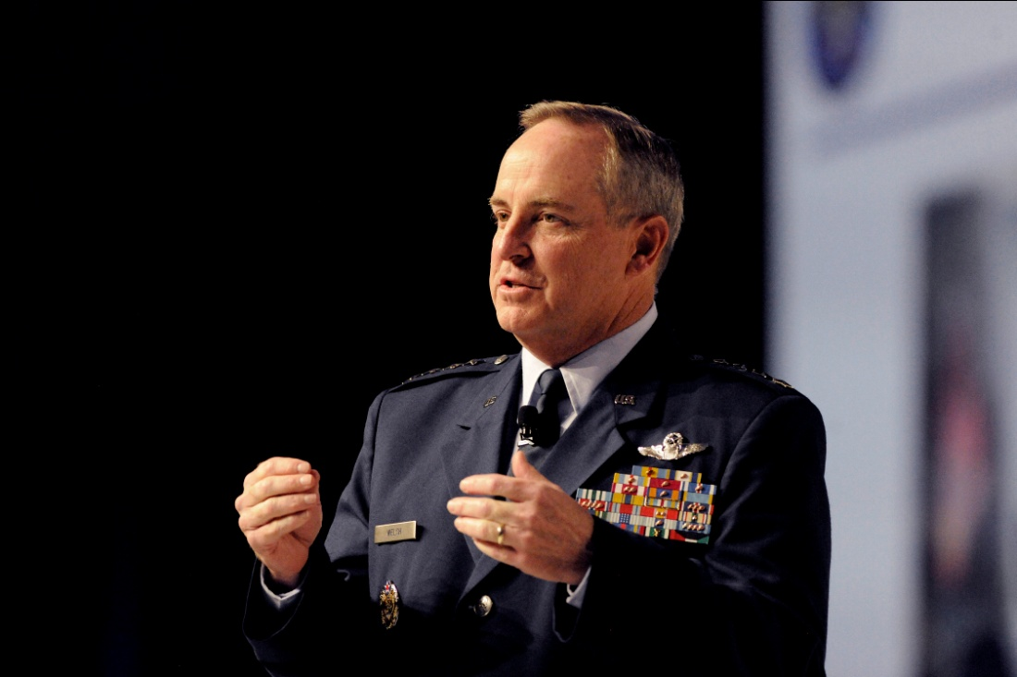
REASONS TO ENGAGE
It is our
obligation
It is our opportunity
We want
ownership
of the issue
Air Force Chief of Staff Gen. Mark A. Welsh III presents the "State of the Air Force" during the Air Force Association Air and Space Conference and Technology Exposition in Washington, D.C., Sept. 18, 2012.
(U.S. Air Force photo/Scott M. Ash)
Notes:
And we want ownership of the issue. If we don’t tell our story, someone else will, and it may not be accurate.
The Law of Primacy in Persuasion holds that the side of an issue presented first will have greater effectiveness than the side presented subsequently. (http://en.wikipedia.org/wiki/Law_of_primacy_in_persuasion)
Therefore, it’s easier to drive the narrative by being proactive, rather than reacting to speculation and rumors or trying to correct misinformation.

Slide 8
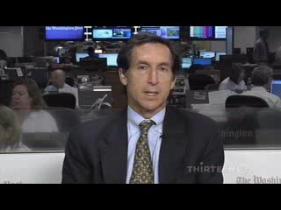
REASONS TO ENGAGE
ILLUSTRATION:
If you don’t tell your story, someone else will…
BP Admits Errors
in Gulf Oil Disaster But Spreads Blame
PBS News Hour
Reporter Judy Woodruff
Washington Post
Reporter Steven Mufson
Notes:
This video illustrates three things:
1) If an organization refuses to comment on a newsworthy issue in a timely manner, reporters will seek remarks from third parties or fellow journalists who may not have all of the facts or represent an organization’s side of the story in the best light.
This happened after BP issued an internal report blaming the largest offshore oil spill in history on a series of human and mechanical failures. Judy Woodruff from PBS spoke with Steven Mufson of the Washington Post about the report (Sep 2010) since BP spokespersons were nowhere to be found after having made so many gaffes in the media in the weeks following the Deepwater Horizon oil rig explosion (20 Apr 2010).
A month into the incident, British Petroleum CEO Tony Hayward told a reporter, “There’s no one who wants this thing over more than I do. I’d like my life back.” (30 May 2010)
Similarly, BP Chairman Carl-Henric Svanberg told reporters, “I hear comments sometimes that large oil companies are greedy companies or don’t care. But that’s not the case in BP. We care about the small people.”
2) Camera presence is as important as the content of a spokesperson’s message.
Steven’s message has substance, but his delivery falls flat. He posture is stiff, and his voice has little inflection.
By contrast, Judy comes across as engaging and conversational. She leans forward, nods, and uses natural hand gestures to flag and illustrate important points. Her tone matches the serious nature of the report and she varies her inflection.
3) Environmental situational awareness. Does the interview setting support or detract from the spokesperson’s message? The two women in the news room behind Steve Mufson are distracting. One is eating, licking her fingers and bobbing her head. Then, her colleague turns around, leans into the frame and curiously looks toward the camera.
A spokesperson can suggest a different camera angle to reduce or eliminate distractions. You don’t know if you don’t ask.

Slide 9
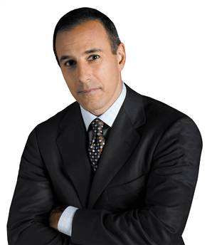
THE MEDIA LANDSCAPE
Consider how your experience with the media may impact your perspective…
What’s your impression of the media?
Matt Lauer – NBC “Today” show anchor
Notes:
So what is your impression of the media?
According to a recent report from the Pew Project for Excellence in Journalism, 72% of Americans feel now most news sources are biased in their coverage (The State of the News Media 2010: http://stateofthemedia.org/2010/overview-3/major-trends/)
What I would suggest is, rather than assessing a story as good or bad news, consider if the reporting is accurate and in context.

Slide 10
THE MEDIA LANDSCAPE
The media landscape shapes news reporting – and how you may be interviewed.
24-Hour News Cycle
Compressed deadlines; need to fill space with short, simple stories
Media Proliferation
Fragmented audiences; intense competition for advertising revenue
Financial Pressures
Fewer experienced reporters; all-in-one journalists; limited research
Multimedia Journalism
News stories now integrate text, still and video images
Notes:
How news is reported and how you may be interviewed is influenced by:
The 24-hour news cycle has compressed reporting deadlines. Journalists need to fill space with short, simple stories that are updated as more details become available. In the news business, if you’re not first you’re last. Audiences are drawn to whichever news outlet is going to give them the latest information – fast.
Technology is fueling the evolution. A news cycle, which consists of reporting on an event followed by reporting on public reaction to the event used to happen at a day-to-day pace until the advent of cable television news. Networks like CNN were a major game changer for the industry and significantly increased the pace of news reporting. Now the Internet, with online news and blogs, has shorted the news cycle even more. (http://en.wikipedia.org/wiki/24-hour_news_cycle)
Media proliferation is fragmenting audiences, who now have options when it comes to how and when they choose to consume news (e.g. DVRs, Smart Phones, etc.). This is changing the news industry’s business model and creates intense competition for advertising revenue. News reporting is not just about informing the public; it’s also a business. Media outlets need to make money from their stories in terms of advertising, so they’re going to report what draws an audience and sells.
Reduced advertising revenue is resulting in financial pressures across the news industry.
Newspaper subscriptions are dropping as people are increasingly getting their news online or from television, resulting in layoffs of reporters who are not multi-faceted or new media-savvy. (http://www.allheadlinenews.com/articles/7020364982?Traditional%20Journalists%20Switch%20to%20Internet%20or%20Face%20Layoffs)
There are pros and cons to fewer experienced reporters.
Pros: It’s an opportunity to share our mission with someone who has a fresh perspective.
Cons: There is an increased possibility that a journalist may unintentionally omit or inaccurately report the facts due to inexperience. Or a new reporter may be inclined toward exposé or sensationalist reporting to get noticed and move up in the industry.
As communication technology advances and news consumption habits change, journalists are now expected to be multimedia experts and produce stories that integrate text, still and video images.

Slide 11
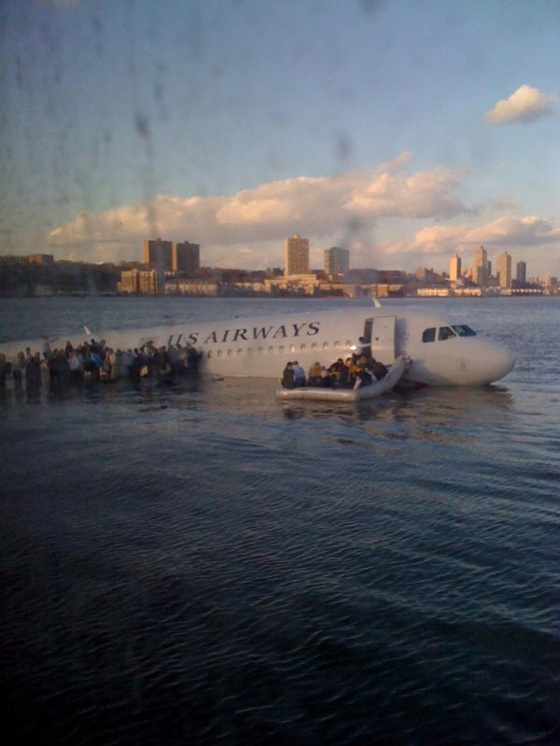
THE MEDIA LANDSCAPE
Convergence of Traditional and Digital Media –
Reaching our target audience in their domain
Traditional Media
Newspapers, Periodicals,
Television, Radio
Digital Media
Content Communities (Youtube),
Social Networking (Facebook),
Blogs / Micro Blogs (Twitter)
Janis Krums posted the first photo of U.S. Airways flight 1549 in the Hudson River on Twitter from his iPhone. MSNBC interviewed him live on TV as a witness 34 minutes after he posted the photo.
Notes:
The convergence of traditional and digital media is presenting new opportunities for us to reach our target audience in their domain.
If Facebook were a country, it would have the third-largest population on Earth. (http://ragan.com/Main/Articles/Adapt_to_technology_changes_or_disappear_Cisco_gur_43886.aspx)
In addition to consuming news from traditional sources…
The rise of digital media is making news an interactive experience with consumers accessing news on their mobile devices, customizing a home page to receive news from multiple sources, and creating or distributing content through social media sites like Facebook or Twitter. (http://www.pewinternet.org/Press-Releases/2010/Online-News.aspx)
And reporters aren’t the only ones carrying cameras and making news. The first mainstream media image of flight 1549 in the Hudson River came from Janis Krums, a tourist aboard a ferry who took the photo with his iPhone and posted it on Twitter.

Slide 12
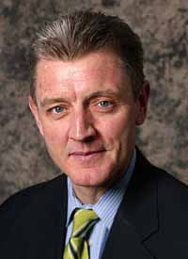
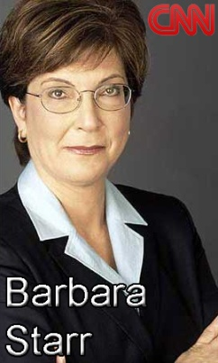
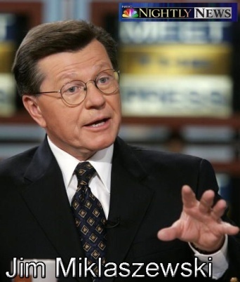
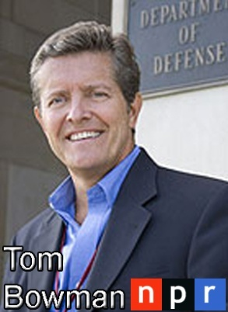
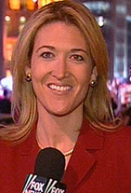


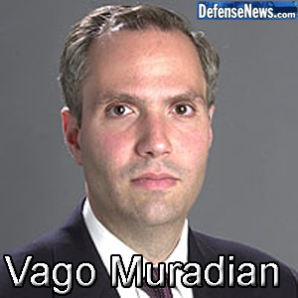
THE MEDIA LANDSCAPE
The Pentagon’s Press Corps:
WIRES
Associated Press (AP)
Bloomberg
Reuters
PRINT
Los Angeles Times
The New York Times
USA Today
The Wall Street Journal
The Washington Post
TV
ABC
CBS
CNN
FOX
NBC
RADIO
ABC
CBS
NPR
TRADES
Aviation Week
Defense Daily
Military Times
“
Jennifer
Griffin
Tom Vanden
Brook
Notes:
These are the various traditional news outlets and some of the journalists you may work with here at the Pentagon.

Slide 13







THE MEDIA LANDSCAPE
Digital Media: Where to find the Air Force
Facebook
United States Air Force
Twitter
@usairforce
Blogger
U.S. Air Force Live
airforcelive.dodlive.mil
You Tube
AF Blue Tube
Flickr
Air Force Photostream
Widgets
RSS Feeds
“
Any journalist who is ignoring new media…isn’t going to be employed – it will be our lifeline. – Dan Ephron, Newsweek
Notes:
These are some of the ways the Air Force is using digital media.
Dan Ephron’s quote reinforces the direction news reporting is headed and the importance of having an online presence. However, digital media is not a panacea. It needs to be driven by a clearly defined communication plan.

Slide 14

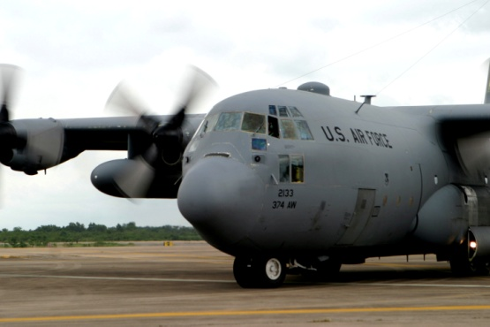
THE MEDIA LANDSCAPE
CASE STUDY:
Traditional
and
Digital Media
used together
C-130 crew delivers aid to Burma following cyclone
ABC Radio Tour
Reporter on flight
broadcast during rush hour in 10 U.S. cities
Blogger’s Roundtable
14 bloggers reported the story in real-time
Notes:
The Air Force leveraged traditional and digital media to tell the story of how it delivered humanitarian assistance to Burma following a cyclone.
A journalist aboard the first C-130 flight reported the news at the top of the hour in each time zone as the mission progressed. At the same time, a bloggers’ roundtable was being hosted via conference call.

Slide 15
THE MEDIA LANDSCAPE
How reporters think:
Timeliness
Proximity
Conflict / Controversy
Change / Progress
Prominence
Emotion
Consequence
Human Interest
Speculation / Suspense
Opinion
Oddity
Infotainment
“
News∙wor∙thy adj \’nüz-wәr-thē\
: interesting enough to the general public to warrant reporting
– Merriam-Webster
Notes:
News isn’t always what we think is important to us as an organization. It’s what the general public thinks is important and/or interesting to them. The audience wants to know, “what’s in it for me.”

Slide 16
THE MEDIA LANDSCAPE
ILLUSTRATION: Why is this story newsworthy?
Timeliness
Proximity
Conflict / Controversy
Change / Progress
Prominence
Emotion
Consequence
Human Interest
Speculation / Suspense
Opinion
Oddity
Infotainment
General: ‘I Don’t Miss The Politics’
Ex-top commander in Afghanistan on scandal, black ops and the war.
USA Today
By Susan Page
ALEXANDRIA, Va. – …“I’m not a media expert, but I knew that the impact of the story would be very, very significant...”
Early Bird: ebird.osd.mil
Notes:
Here is a news headline from [today’s]* Early Bird (http://214.14.134.30/ebird2/ebfiles/e20130107913615.html).
The Early Bird, produced by OSD Public Affairs, “is a daily compilation of published items and commentary concerning significant defense and defense-related national security issues. It aims to represent how the public, Congress and the press see military and defense programs and issues.”
Why do you think the media considered this story to be newsworthy?
Being aware of what’s making local, national and international news each day will help you understand how your organization’s story may fit into the current news narrative.
For example, if there’s a national news story about DOD budget cuts, a regional or local news reporter that covers your area may want to know if/how your installation and/or organization may be impacted.
*NOTE: Update this slide with a news story taken from the Early Bird the day before or the day of the client’s training.

Slide 17
THE MEDIA LANDSCAPE
ILLUSTRATION: Why is this story newsworthy?
Timeliness
Proximity
Conflict / Controversy
Change / Progress
Prominence
Emotion
Consequence
Human Interest
Speculation / Suspense
Opinion
Oddity
Infotainment
Obama’s Pick For Defense Is An Ally, And A Lightning Rod
New York Times
By Scott Shane and David E. Sanger
WASHINGTON – …The choice of Mr. Hagel, the first Vietnam veteran to be nominated for the post, would add a prominent Republican to Mr. Obama’s cabinet, providing some political cover for the president’s plans to exit Afghanistan and make cuts to a military budget that has roughly doubled since the 2001 terrorist attacks.
Notes:
http://214.14.134.30/ebird2/ebfiles/e20130107913601.html
Discussing one story from the Early Bird is usually enough to illustrate the point, but you may want to include two stories if you think the second illustration is important enough to be value added for the client.

Slide 18
THE MEDIA LANDSCAPE
ILLUSTRATION: Why is this story newsworthy?
Timeliness
Proximity
Conflict / Controversy
Change / Progress
Prominence
Emotion
Consequence
Human Interest
Speculation / Suspense
Opinion
Oddity
Infotainment
Senators To Probe Air Force’s $1 Billion Failed Software
Bloomberg.com
By Tony Capaccio
Computer Sciences Corp.’s performance on a failed $1 billion software project for the U.S. Air Force and the service’s management of it are under investigation by the Senate Armed Services Committee.
Early Bird: ebird.osd.mil
Notes:
http://214.14.134.30/ebird2/ebfiles/e20130107913601.html
Discussing one story from the Early Bird is usually enough to illustrate the point, but you may want to include two stories if you think the second illustration is important enough to be value added for the client.

Slide 19
MESSAGE DEVELOPMENT
PREPARATION is key to a successful interview!
Define your communication objective
Coordinate with Public Affairs and your chain of command
Build your messages
Anticipate basic and challenging questions
Prepare your answers
Practice your responses
“
I needed some serious media training. I did it on the job but I could have saved myself a lot of hassle if I had done it earlier on. – AP Interview: Howard Dean Looks Back
Notes:
Mission planning is vital to success – especially media interviews.
First, define your communication objective. It’s impossible to hit a target that hasn’t been clearly defined. The reporter will come with their story agenda, but you should also determine in advance what you expect to achieve from the interview.
Enlist the expertise of your public affairs office and your chain of command. If all concur that you should move forward with the interview…
Build your messages. These are three to five takeaway statements you want your audience to remember that achieve your communication objective.
List the obvious who, what, where, when and why questions – and the challenging or opposing questions you hope never come up during the interview so you’re not caught off guard.
Prepare answers to your list of questions based on the type of interview format since it will determine the length of your responses. Print interviews allow you more time to answer and provide background information. Answers for broadcast interviews need to be short and to the point.
Then practice your responses to see if your written answers are easy to say. Are they simple, natural and conversational?

Slide 20
MESSAGE DEVELOPMENT
Understand who you’re talking to:
Reporter
Experience
Interviewing Style
Relationships / Sources
Balanced / Sensational
Reputation with audience
Potential story bounce?
Audience
Demographics
Location
Knowledge level
Why do they care?
News
Medium
Notes:
Effective communication begins with understanding who you’re talking to.
Is the interview with a seasoned or novice reporter?
Is their style conversational or confrontational?
Consider how a reporter’s associations/sources may influence their line of questioning or framing of the story.
And bounce is just an industry term that means a story may get picked up by other news outlets, providing additional opportunities to reach a broader audience.
As a spokesperson, it’s important to remember that although an interview with a journalist may feel like a one-on-one conversation, the purpose is to inform a larger audience – not only for the journalist’s benefit, but yours, too. The reporter and the news medium are just conduits for delivering your message to your target audience.
Are you trying to reach a broad or niche audience?
Are they interested in news of local or national consequence?
Are they highly knowledgeable about your mission, or is this the first time they may be hearing about it?
And, going back to the factors that make a story newsworthy – Why should the audience care about what you have to say? What’s in it for them?
All of these factors will influence how you may choose to answer the reporter’s questions.

Slide 21
MESSAGE DEVELOPMENT
Understand the interview format:
Television
Studio Interview
Remote Interview
Ambush Interview
Stand-up / On-scene Interview
Edited Interview
Print
One-on-One Interview
Editorial Board
Letter to the Editor
Opinion / Editorial Piece
Audio Only
Phone-in Interview
Radio Interview
Blogger’s Roundtable Interview
Combined Media
Press Conference
Media Availabilities
All-in-One Reporter
Citizen Journalist
Notes:
Next, understanding the interview format is important because it affects how your message will be conveyed.
Is it print or broadcast?
Print interviews allow you to go into more detail and provide additional context.
Messages for broadcast interviews need to be more concise.
Is the broadcast interview edited or live?
During an edited interview, you can pause before answering, and you can ask to either have the reporter restate the question or you can restate your answer if it doesn’t come out the way you would like the first time. More often than not, pauses and awkwardly stated answers will be edited out of the final cut.
However, live interviews are just that. The interview starts and runs straight through while being broadcast in real time.
Are you speaking with one reporter or several?
Regardless of the interview format, you are in control. The reporters may own the questions, but you decide how you choose to respond.
A technique for maintaining control during a combined media event is called “spotlight/floodlight.” Start your response by directing it toward the reporter who asked the question; then break your gaze with that reporter as you share the rest of your response with the entire press pool. When you finish, you’ll be looking at a different reporter, which makes it easier to move on to the next reporter’s question without appearing rude or avoidant.

Slide 22
MESSAGE DEVELOPMENT
What is a message?
Key bits of information you want your audience to know in a form the media can use
Effects-based: Designed to achieve communication goals
Repeatable to help cut through the clutter
Always tied to a factual answer
“
Sometimes they write what I say and not what I mean.
– Baseball player Pedro Guerrero on reporters
Notes:
Every response should include one of your key messages.
A message is key bits of information you want your audience to know, in a format the media can use…
To achieve your communication objective
It should be something you can repeat and restate throughout the interview.
To illustrate the point, imagine the interview as a long piece of video tape. If you state your message once up front, and the producer decides to cut the tape and use a piece from the middle of the interview, your message will be lost on the cutting room floor. However, if you repeat and restate your message, it reinforces its importance and having it appear several times along the virtual video tape increases the odds that it will not be edited out of the interview.
And always tell the truth. Never spin or speculate.

Slide 23
MESSAGE DEVELOPMENT
Telling your story in 10 seconds or less:
10 seconds =
35 words
“I fear they do not know us. I fear they do not comprehend the full weight of the burden we carry or the price we pay when we return from battle. (7/24)
– Former Chairman of the Joint Chiefs of Staff Adm. Mike Mullen
Notes:
Be brief. The more you say, the more you stray.
The goal is getting your message down to a statement of 10 seconds or less. The average TV story is 90 seconds long and the average print story has 36 sentences (http://braudcommunications.com/pdf/BP_Oil_Spill_Braud.pdf). Tight, punchy responses are key to being quotable.
To illustrate how you can be short, yet conversational, in your responses: this two-sentence quote from former Chairman of the Joint Chiefs of Staff Admiral Mike Mullen is 31 words combined – 7 words for the first sentence and 24 words for the second sentence, yet is still conversational and not stifled.
Quote taken from:
As the ‘Civilian-Military Gap’ Increases, Support for Personnel Needs to Grow
http://214.14.134.30/ebird2/ebfiles/e20130107913608.html
U-T San Diego
January 6, 2013
Pg. 17
By Scott McGaugh, Special to the U-T

Slide 24
MESSAGE DEVELOPMENT
Telling your story in 10 seconds or less:
10 seconds =
35 words
Decide what headline you want
What you want your audience to remember
Write your message down
Evaluate your message; it must be short, memorable and relevant
Good message format:
Headline Statement
Supporting Point 1
Supporting Point 2
Notes:
Think about how newspaper headlines are written – short and to the point.
Does it make sense when you write it down? Is it stated in conversational terms that are relevant to your audience?
State your bottom line up front and follow with a couple of supporting points to illustrate your headline statement.
It’s one thing to say, “we have the best air, space and cyberspace force in the world” – which we do; but that headline statement needs to be substantiated with supporting points such as facts, illustrations and examples that paint a picture in the audience’s mind. It also closes the “say-do” gap and keeps your messages from being just empty rhetoric.

Slide 25
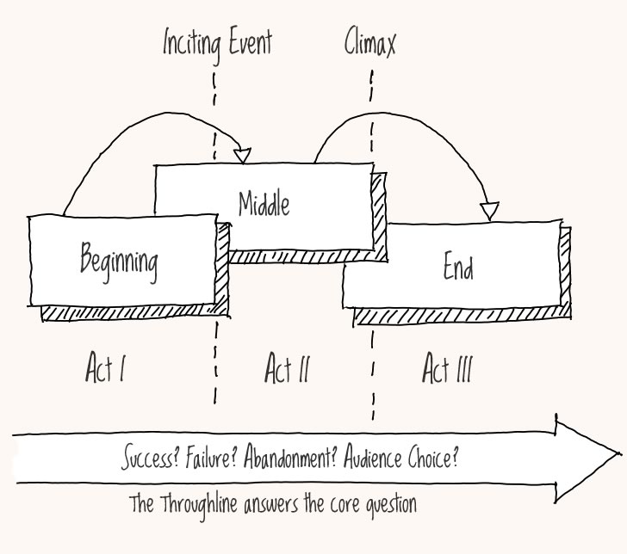
MESSAGE DEVELOPMENT
To make your message more “quotable” try using:
Stories / Anecdotes
Characters, setting, narrative
“
Reporters don’t write announcements; they write stories.
– Gordon Platt, former producer of ABC “Nightline”
Notes:
Storytelling entertains and informs at the most basic level of understanding.
Think about the elements of every good story:
Characters: Who’s the protagonist/antagonist? Who’s being impacted? Who does the audience relate to?
Setting: What is the context? Is there a local association for the audience?
Narrative: How could this happen? How did this happen? Was there a main turning point or moment of decision that produced interesting or unexpected results? How does this story relate to other current news? What does this mean?

Slide 26
MESSAGE DEVELOPMENT
To make your message more “quotable” try using:
Stories / Anecdotes
Characters, setting, narrative
Tripartite Division
Complex to simple in three steps
“
We search for new technology; we put it to the test; and we deliver it to the warfighter.
– Integrated Warfighter Technology
Notes:
Complex ideas are easier to understand and remember if simplified into three steps/parts.
e.g. Integrated Warfighter Technology: search, test, deliver.

Slide 27
MESSAGE DEVELOPMENT
To make your message more “quotable” try using:
Stories / Anecdotes
Characters, setting, narrative
Tripartite Division
Complex to simple in three steps
Figures of Speech
Imagery, Analogies, Similes, Metaphors
“
If you’re driving at a brick wall at 60 miles per hour, let’s try to find a way to avoid the wall, not try to find a way to pick up the pieces after we hit it.
– DOD Comptroller Robert Hale on Sequestration
Notes:
Figures of speech are another way to paint word pictures in an audience’s mind and make things easier to understand and remember.

Slide 28
MESSAGE DEVELOPMENT
To make your message more “quotable” try using:
Stories / Anecdotes
Characters, setting, narrative
Tripartite Division
Complex to simple in three steps
Figures of Speech
Imagery, Analogies, Similes, Metaphors
Repetition
“
If you have an important point to make, don’t try to be subtle or clever. Use a pile driver. Hit the point once. Then come back and hit it again. Then hit it a third time – a tremendous whack. – Sir Winston Churchill
Notes:
Repeating and rephrasing your message throughout an interview may feel unnatural, but it’s essential.
If you state your message once at the beginning of an interview, someone who tunes into the broadcast halfway through will have missed the point.
- or-
Think of your interview as a long piece of video tape. If you state your message once at the beginning, and the editor decides to use one of your statements from the end of the interview, your message will have been lost on the cutting room floor.
Rephrasing and restating your message throughout the interview reinforces the importance of what you’re trying to say and increases the odds that it will be included in the final production.

Slide 29
MESSAGE DEVELOPMENT
Emphasize the positive
“
I’ve done nothing wrong, and my integrity is intact, and my conscience is clear.
– John Yates, Scotland Yard’s former assistant commissioner
Notes:
“Emphasizing the positive” in an interview doesn’t mean ignoring unflattering facts when there’s been an incident/accident, but do so while avoiding negative, sensationalist or emotionally charged language and state what proactive measures are being taken to address the situation.
What if Nixon had said, “I’m an innocent man,” instead of, “I’m not a crook”? (emotional/color words: innocent vs crook)
Yates quote: (http://www.telegraph.co.uk/news/uknews/phone-hacking/8647837/Phone-hacking-John-Yates-insists-I-have-done-nothing-wrong.html)

Slide 30
MESSAGE DEVELOPMENT
Emphasize the positive
Don’t repeat the negative
“
…while we can never say it can never happen again, we do think we’ve taken steps that really address the issues that were raised. So for example…
– Mary Shapiro, Security Exchange Commission Chairman
Notes:
Don’t repeat the negative.
ILLUSTRATION: SEC Chairman Shapiro provided the following response when American Public Media Marketplace reporter Tess Vigeland asked “Can this happen again?” in reference to another stock market flash crash. The negative speculation in the chairman’s answer was reattributed to her in the last question of the interview when the reporter said, “How concerned are you about a lack of investor confidence in the system? Given that something like this -- in your own words -- could happen again?”
Shapiro quote: (http://marketplace.publicradio.org/display/web/2011/05/05/pm-how-wall-street-has-changed-since-the-flash-crash/)

Slide 31
MESSAGE DEVELOPMENT
Emphasize the positive
Don’t repeat the negative
Avoid jargon, acronyms and scientific terms
“
Nationwide, three-in-ten adults have college degrees.
– Pew Research Center for the People & the Press
Report: Americans Spending More Time Following the News
Notes:
Avoid jargon, acronyms and scientific terms.
Imagine that you’re explaining your job responsibilities or mission at a middle school career day since “the average adult reads at the ninth-grade level,” and “for recreation, people read texts that are two grades below their actual reading level.” (http://en.wikipedia.org/wiki/Readability)
Pew statistic: (http://people-press.org/2010/09/12/section-4-who-is-listening-watching-reading-and-why/)

Slide 32
MESSAGE DEVELOPMENT
Emphasize the positive
Don’t repeat the negative
Avoid jargon, acronyms and scientific terms
Use active voice with high-energy words
“
Active: Operator error caused the accident.
Passive: The accident was caused by operator error.
Notes:
Active voice statements with high-energy words are more concise and impactful than passive voice.

Slide 33

MESSAGE DEVELOPMENT
Emphasize the positive
Don’t repeat the negative
Avoid jargon, acronyms and scientific terms
Use active voice with high-energy words
Replace long words and phrases with conversational language
U1
T1
I1
L1
I1
Z10
E1
Notes:
“Use” vs. “Utilize”
This isn’t Scrabble where we get an extra 50 bonus points for using all of our letters.

Slide 34
MESSAGE DEVELOPMENT
Emphasize the positive
Don’t repeat the negative
Avoid jargon, acronyms and scientific terms
Use active voice with high-energy words
Replace long words and phrases with conversational language
Structure your responses like an “inverted pyramid”
WHO – WHAT – WHEN – WHERE – WHY – HOW
IMPORTANT INFORMATION
OTHER DETAILS
LESSER DETAILS
Notes:
The inverted pyramid is a metaphor used by journalists that means “bottom line up front.” A reader or viewer can walk away from the story at any point and still understand it since the who, what, when, where, why and how were stated up front in the summary news lead.

Slide 35
THE INTERVIEW
Set ground rules and establish the type of attribution:
On-the-record
Consider everything you say as “on-the-record.” Never say anything you don’t want to see printed or broadcast.
Quotes and paraphrases are attributed to your name and title.
Background
Allows you to provide context to stories without being directly quoted
“According to a senior Defense official…”
“It has been learned that…”
Off-the-record
Nothing you say may be reported.
Information is meant for the journalist’s education only.
There is always a risk that the reporter will not honor your agreement.
Notes:
Prior to the interview, it’s vital to set the ground rules and establish the type of attribution so that there’s no misunderstanding as to how your remarks will be acknowledged in the story. Stick with one type of attribution per interview to avoid confusion and unpleasant surprises when the story is published. The type of attribution you and the reporter agree on is based upon your relationship and the nature of the issue being discussed.
In general, consider everything you say from the time you’re in the presence of a reporter until the time they leave as being “on the record.” Quotes and paraphrases will be attributed to your name and title.
Yellow means caution. However, if you have a well-established relationship with the reporter, and you know they will more than likely honor your agreement, you may choose to go on “background” if there is benefit in releasing information to the media prior to being authorized to make an official statement about it.
Remarks made on background are attributed to a generic title. Whereas statements made on deep background are introduced in terms such as “it has been learned that…”
Red is stop. It is recommended to never go off the records because there is always a risk that the reporter will not honor your agreement.

Slide 36

THE INTERVIEW Techniques
ILLUSTRATION:
Ground rules – a reporter’s perspective
How Amanpour knew where Osama bin Laden was
CNN Reporter
Christiane Amanpour

Slide 37
THE INTERVIEW Techniques
A statement that leads the reporter to ask a question directly related to your key point(s)
Define/refine the interview topic.
“I understand we will be talking about [TOPIC] today. Has that changed?”
“Something that has bearing on the issue we haven’t discussed is…”
“A new development likely to interest your audience is…”
HOOKING
Notes:
Four techniques to help you maintain balanced control during the interview include hooking, blocking, bridging and flagging.
Hooking is using the casual conversation with the reporter prior to broadcast to:
1. avoid a bait-and-switch situation by ensuring the original agreement has not changed
2. get an idea of the reporter’s story angle and if they’re talking to other sources, and
3. define/refine the interview topic by getting the reporter interested in your key message areas

Slide 38
THE INTERVIEW Techniques
Speak to the bigger issue behind a pointed or unproductive question.
Politely refute, but don’t repeat negative or inaccurate statements.
“That speaks to a bigger point…”
“I’m unable to be more specific for security reasons…”
“That’s not the case…”
“To the contrary…”
BLOCKING
Notes:
Spokespersons often ask, “what do I do if I get asked a question like this?” And it’s usually in reference to a question that is pointed, sensationally worded or has a no-win option.
Blocking is a technique you can use to – not dodge or avoid the question, which can come across as shifty or dishonest – but speak to the bigger issue behind that type of question.
If the question is phrased with negative, emotionally charged language, speak to the premise of the question without repeating the reporter’s statement.
If the assertion is completely wrong, politely refute, but don’t repeat the incorrect information.
And if you can’t answer because of classification, say so…then move on to the next interview technique called…

Slide 39
THE INTERVIEW Techniques
Briefly address the reporter’s question; then “bridge” to a message and supporting facts that achieve your communication objective.
“…but what I can tell you is…”
“Even more importantly…”
“From a broader perspective…”
“Here’s what we know…”
BRIDGING
Notes:
…bridging.
Once you address the reporter’s question, smoothly transition to your related message and supporting points to achieve your communication objective.
Here are some examples of bridging statements.

Slide 40
THE INTERVIEW Techniques
Use voice inflection, pauses, and/or hand gestures to emphasize important points.
“The three main objectives are…”
“The most important thing to remember is…”
“Our first concern is…”
FLAGGING
“
The right word may be effective, but no word was ever as effective as a rightly timed pause.
– Mark Twain
Notes:
The fourth technique is flagging, which is using verbal and non-verbal cues to emphasize your important points.
A note about hand gestures:
Ensure they’re high enough to be seen in the frame of a broadcast interview
Avoid finger pointing since it can be negatively interpreted as confrontational or scolding; instead, use a closed fist or “knife hand”

Slide 41
THE INTERVIEW Techniques
Never just “answer” or “message” in response to a question
Answer + Message = RESPONSE
Notes:
A media interview is a conversation, but a conversation with an objective – to effectively connect with your target audience.
Therefore, an answer and a message equals a complete response.

Slide 42
THE INTERVIEW Techniques
Never just “answer” or “message” in response to a question
Answer or Message = RESPONSE
Notes:
Just answering a reporter’s question without a related message doesn’t achieve your communication objective, only the reporter’s agenda.
And avoiding the reporter’s question altogether by just responding with a message makes you look unknowledgeable about the reporter’s topic at best and slick, evasive and/or dishonest at worst.

Slide 43
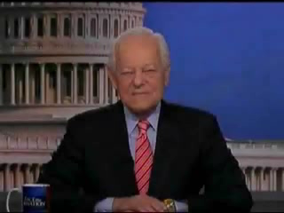
THE INTERVIEW Techniques
ILLUSTRATION:
Answer + Message = Response
Schieffer on getting politicians to answer questions
Face the Nation
Reporter Bob Schieffer
Notes:
Face the Nation commentator Bob Schieffer explains why.

Slide 44
THE INTERVIEW Techniques
Personal credibility: YOU are the expert!
Use personal authority, experience
Establish professional credentials
“From my 28 years of experience…”
“When I flew the B-52…”
“My perspective as a former _______ commander…”
Critics aren’t shy – you can’t be!
Notes:
Oftentimes, your job title doesn’t fully explain to the audience what it is that you do and why you’ve been selected as a knowledgeable spokesperson for the interview topic.
Therefore, it’s okay to use your personal authority and experience in your responses.
It’s not bragging; it’s establishing your credentials and credibility as a spokesperson.

Slide 45
THE INTERVIEW Techniques
Remember…
HOW you say it is as important as WHAT you say
Notes:
And, how you say it is as important, if not more so, than what you say.
Studies have shown that:
Only 7% of communication is what someone says
58% is how it is said – tone and inflection
And 35% is non-verbal body language

Slide 46
THE INTERVIEW Techniques
Remember…
HOW you say it is as important as WHAT you say
Body Language & Verbal Inflection
Notes:
93% of a spokesperson’s communication is dependent upon their body language and verbal inflection; that is why on-camera practice and video playback before a real-world interview is vital – whether it’s in a professional studio, or in an office with a Flip cam on a tripod.

Slide 47
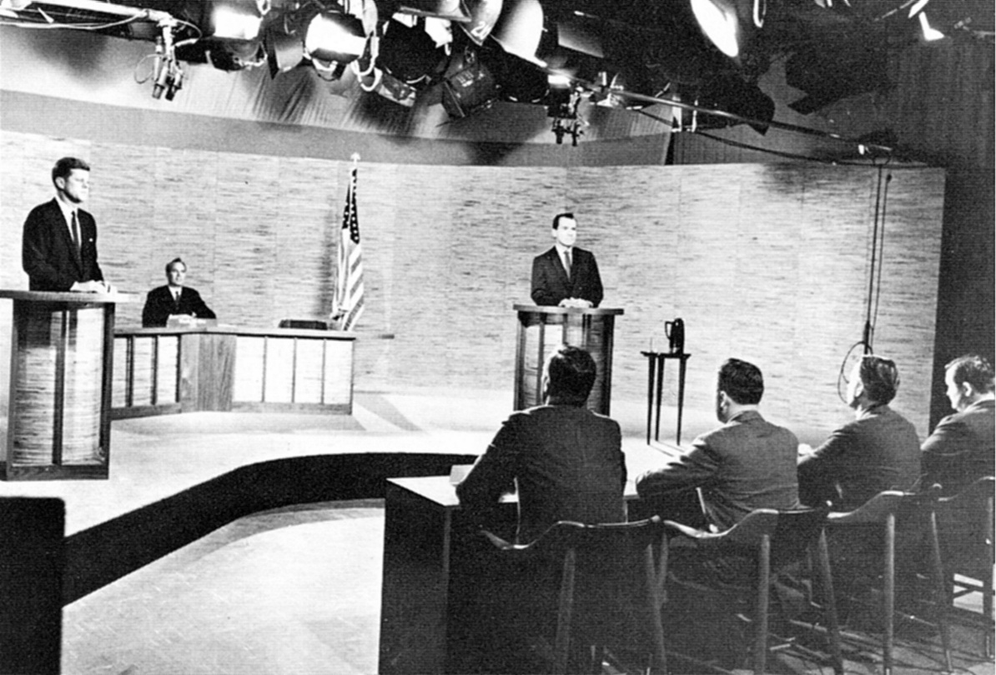
THE INTERVIEW Techniques
ILLUSTRATION:
1960 Nixon-Kennedy Debate
Notes:
Image: http://en.wikipedia.org/wiki/File:Kennedy_Nixon_Debat_(1960).jpg
How the Nixon-Kennedy Debate Changed the World
http://www.time.com/time/nation/article/0,8599,2021078,00.html

Slide 48
THE INTERVIEW In Crisis
Navigating a crisis:
1.
Warning(s) / turning point
“
Cri∙sis noun \’krῙ-sәs\
3a: an unstable or crucial time or state of affairs in which a decisive change is impending; especially : one with the distinct possibility of a highly undesirable outcome
– Merriam-Webster
Notes:
When a crisis happens, it usually evolves in four phases.
During phase one, there may or may not be obvious warning signs, and the public may not yet be aware of the incident/issue.

Slide 49
THE INTERVIEW In Crisis
Navigating a crisis:
1.
Warning(s) / turning point
2.
Point of
no return
“
Your credibility depends on:
Caring
Competence
Commitment
Honesty
Notes:
However, during phase two, the public is now aware of an incident/issue that must be addressed soonest (usually within 24 hours) in order to avoid negative repercussions – such as loss of reputation, confidence, or public support – that may require more effort to rebuild in the long-term than if a spokesperson had been responsive in the short-term.
In a crisis, a spokesperson’s credibility depends on how the public perceives their level of:
Concern about the incident and those affected by it
Competence – level of authority and knowledge as it relates to the issue
Commitment to resolving the issue
Honesty

Slide 50
THE INTERVIEW In Crisis
Navigating a crisis:
1.
Warning(s) / turning point
2.
Point of
no return
“
Be prepared to answer…
What happened?
What caused it?
What are you doing about it?
Notes:
At a minimum, the spokesperson should be prepared to answer the following three questions to the extent they’re able to at that time.

Slide 51
THE INTERVIEW In Crisis
Navigating a crisis:
1.
Warning(s) / turning point
2.
Point of
no return
3.
Clean up
phase
“
Provide timely updates…
Confirm facts
Dispel rumors
Clarify details
Notes:
The clean-up phase is the longest of the four phases.
The spokesperson’s role is to provide timely updates that:
Confirm facts
Dispel rumors
Clarify details

Slide 52
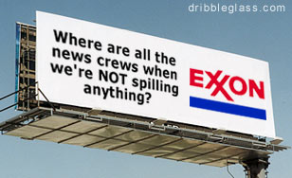
THE INTERVIEW In Crisis
Navigating a crisis:
1.
Warning(s) / turning point
2.
Point of
no return
3.
Clean up
phase
4.
Return to
normal
Notes:
The fourth and final phase is a return to normal.

Slide 53
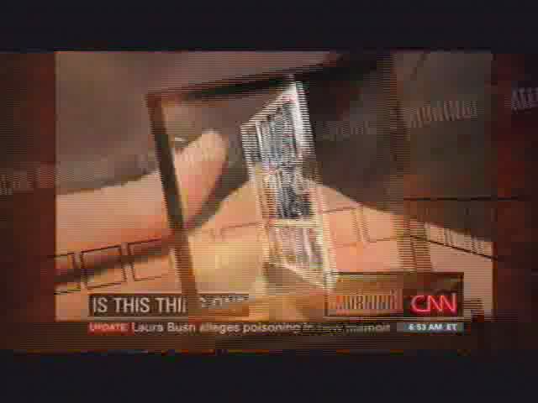
THE INTERVIEW In Crisis
ILLUSTRATION:
The camera is always on, and the mic is always hot…
Is This Thing On?
CNN American Morning
Reporter Jeanne Moos
Notes:
One way to avoid a crisis is to remember that from the time a reporter is in your presence until the time they leave, the camera is always on and the mic is always hot.

Slide 54
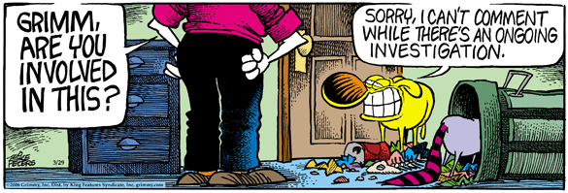
CONCLUSION
Key points:
Be yourself
Know your facts
Stay in your lane
“No comment” is not an answer
Notes:
Now after all we’ve discussed today, just relax and be yourself (usually elicits a laugh).
Know your facts – on both sides of the issue
Stay in your lane – speak only to that which is in your area of responsibility
“No comment” is not an answer. What do you think when you hear someone say, “no comment” in an interview? If there’s a reason why you can’t directly answer the question (e.g. due to classification), say so. Then bridge to a related message and supporting points.

Slide 55
CONCLUSION
Key points:
Be yourself
Know your facts
Stay in your lane
“No comment” is not an answer
Asking for a restart is okay
Protect and correct the record
Talk headlines, not history
“I don’t know, but my PA will follow up” is okay
Repeat and restate
Notes:
Asking for a restart is okay – especially during edited interviews. It’s in the best interest of the spokesperson and reporter who both want good sound bites.
Protect and correct the record. It’s always easier to protect the record by getting accurate information out first, rather than trying to come back later and correct the record. 1) It diminishes the spokesperson’s (and their organization’s) credibility if what they say is not accurate – intentionally or not. 2) Do you really want to draw attention back to an issue, especially if it’s a negative story? 3) Print corrections are usually run in non-prominent places where the audience is not likely to see it; and broadcast corrections lack impact because the audience may not have heard or remembered the original story to make the connection.
Talk headlines, not history. Old news isn’t “news,” unless there’s a new development to an old story
“I don’t know but my PA will follow up” is okay. Having the PA follow up ensures that ground rules with the reporter are maintained and the spokesperson’s time is respected.
Repeat and restate your messages and supporting points to increase the odds they will survive the editing process.

Slide 56





CONCLUSION
Control is the key to success
Messages are your lifeline
Confidence comes with preparation and engagement
Engage for the Joint Force!
Notes:
Regardless of the interview format, you are in control. The reporter may own the question, but you own the response.
Each response should address the reporter’s question and contain a message and supporting points that keep you on course to achieving your communication objective.
Just like learning a new sport, instrument or skill, confidence comes with practice and engagement.

Slide 57
For questions, contact your unit public affairs office or:
Secretary of the Air Force Public Affairs Engagement Division
Media and Opinion Leader Engagement Branch
1690 Air Force Pentagon | Washington DC20330-1690
703.692.3231 | 703.695.9664 | MediaTraining@pentagon.af.mil
- - - - - - - - - - - - - - - - - - - - - - - - - - - - - - - - - - - - - - - - - - -
Slides designed by: HAF/IMMG Graphics (Pentagon) and SAF/PAYM
MT12-003

